Slide 1

Philips Products Analysis And Decision Making
Presented by: Abdullah Mahmoud Aldous

Slide 2

Introduction
I chose ‘Philips’ company to be my research and analysis target of my study. I am comparing three Philips products to find insights and reach to useful recommendations.
Philips company is a Dutch manufacturer company for electronics, medical equipment, computer and telecommunications equipment. (www.britannica.com, 2024)

Slide 3

Data of the three products
Products Selected:
1. Philips Sonicare G2 Optimal Gum Care Brush Heads
2. PHILIPS Over Ear Open Back Stereo Headphones Wired with Detachable Audio Jack, Studio Monitor Headphones for Recording Podcast DJ Music Piano Guitar (SHP9600)
3. Philips Multi Groomer All-in-One Trimmer 23 Piece Grooming Kit, Trimmer for Beard, Head, Body, and Face Series 7000
Data Was gathered for 1 year (3/5/2023 to 3/5/2024)
Data Source: Amazon using Helium 10 tool
Data format: Excel files and after that grouped in one file named “Products”, then each file was converted to csv. (Structured Data)

Slide 4
Data Description and Relevance
Collected Columns:
Time: Date and time of record
Sales Rank: Popularity indicator, as lower the rank is, as the product is more popular
New Price: Actual Price
List Price: Manufacturer’s suggested price
Relevance:
Track product demand over time along price changes (Sales Rank with New Price)
Analyzing pricing and promotions strategies (Discount with Sales Rank)
Identify trends and seasonal patters (Sales Rank with Time)

Slide 5

Tools and Technologies Used
Hellium 10: To import data of the three products from Amazon.
Excel: To group the three products in one sheet, handle missing values, and data exploration.
Power BI: Visualize data to find insights and recommendations. Also, finding relationships between features such as new price and sales rank.
Orange: To predict sales rank for the three products to take the suitable measure.

Slide 6

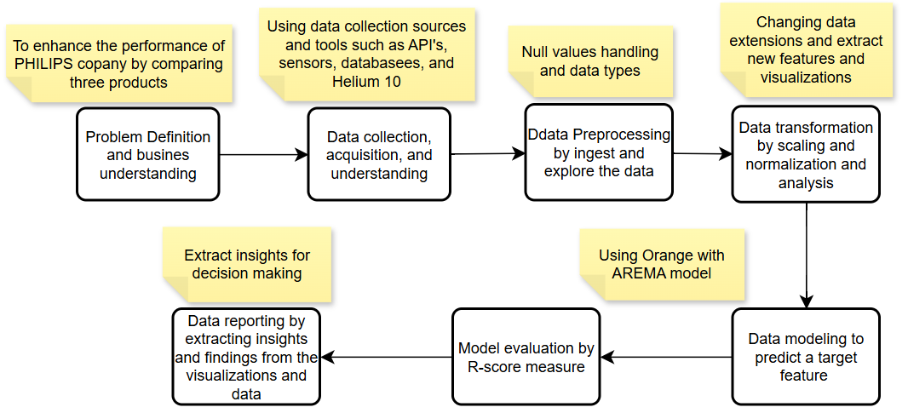
Data science solution Flowchart
(GeeksforGeeks, 2020)

Slide 7
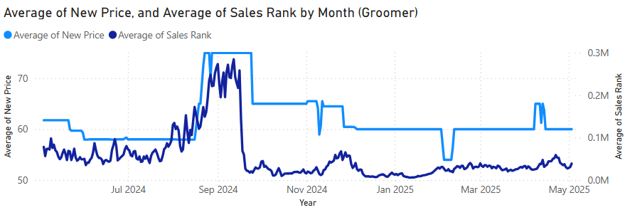
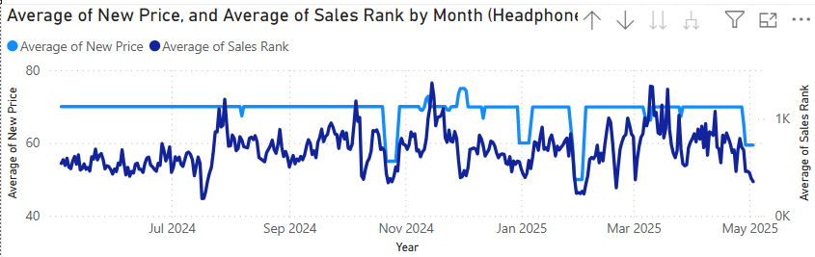
Insights and Recommendations
This chart shows how directly sales rank and new price are. In most months and days, the new price increases the sales rank increases also.
This indicates that customers carry very well about the price, that’s why the sales rank becomes better when price is lower for the three products
If PHILPS plans to have better sales rank, they should lower the price in a way that it cause a small revenue but with big effect on sales rank.

Slide 8
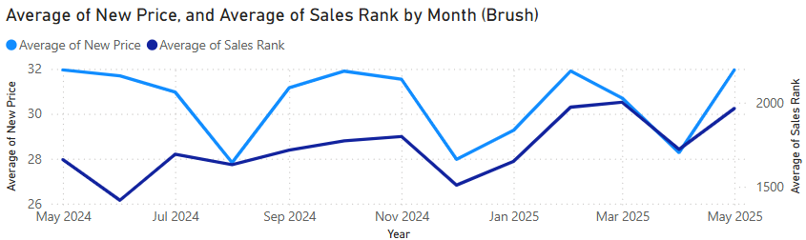
Insights and Recommendations
As we can see here it the new price is directly related to sales rank for the brush product as in the previous two products. Achieving Lower sales rand (Better) can be due to lower price

Slide 9
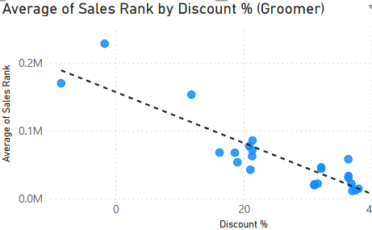
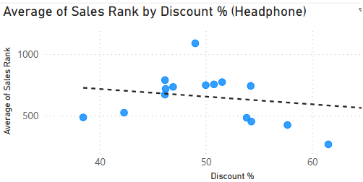
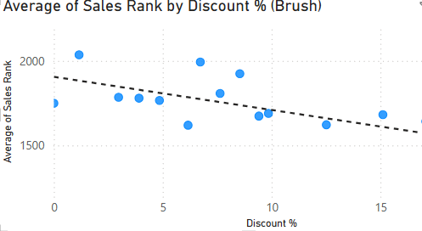
Insights and Recommendations
These scatter plots shows how sales rank is decreasing as the discount increases in the three products. I recommend PHILIPS company to increase discounts in a manner that decreasing sales rank but preserving only potential loss to achieve high reward in the future

Slide 10
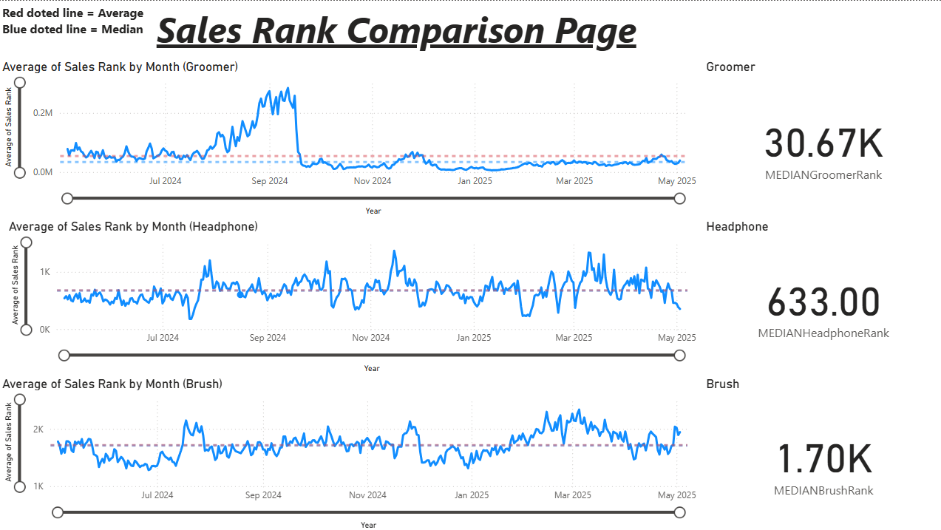
Insights and Recommendations
As shown in the three-products line charts (Rank vs time) and for the measures that represent the median sales rank for each product, we can notice that the products popularity are in this order:
Headphone
Brush
Groomer (unpopular)
Also, the worse rank for Groomer product was in September 2024

Slide 11

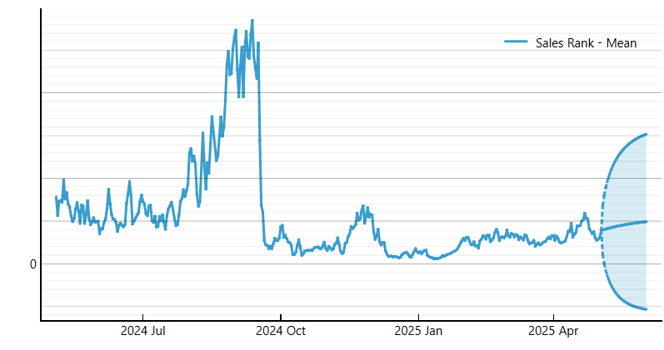
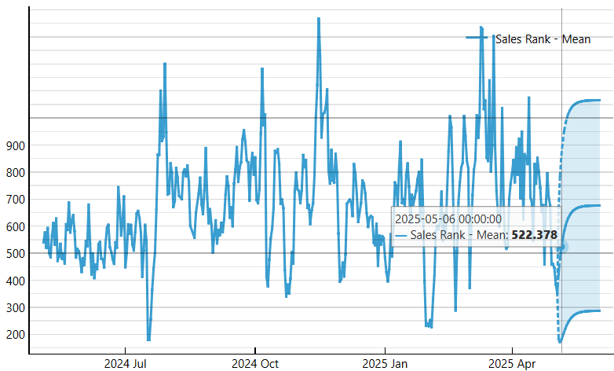
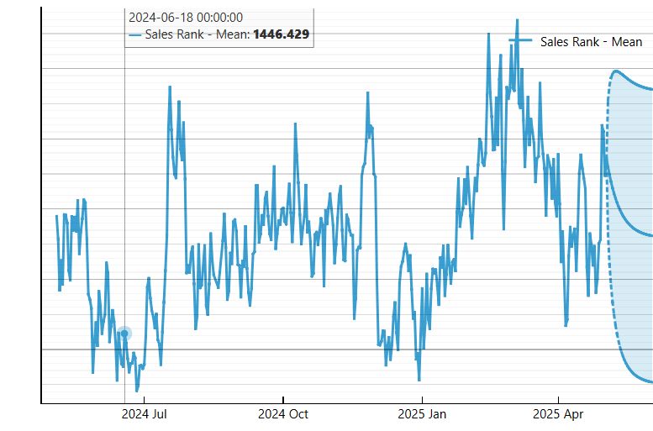
Insights and Recommendations
Groomer
It is predicted to have constant sales rank for Groomer, so it is recommended to focus on marketing and lowering price.
It is predicted to have a high sales rank for headphones which is bad for our business, that's why we must increase discount
Brush will have lower sales rank which is a positive indicator, so we must produce more brushes
Headphone
Brush

Slide 12
Insights and Recommendations (Bullet Points)
Consumers are price sensitive, so lower prices improved sales ranks
Philips can strategically reduce prices to enhance rank without incurring significant revenue loss
More discounting is linked to improved sales rank
Philips can discount to maximize long-term gain
Median sales rank reflects popularity in this order: Headphone > Brush > Groomer
Groomer had lowest rank in September 2024
It is recommended to stop producing Groomers or changing the marketing strategy to cover more targeted audience

Slide 13
Evaluation of my data science solutions (Against user and business requirements)
Focused on improving sales performance and marketing strategies which is aligned with business requirements
Using data science tools like Excel, orange, and Power BI helps to find solutions based on data without any human bias, which aligns with business requirements.
Charts simplify understanding overall product status and clarify relations between features which aligns with business requirements.
Customers will be more satisfied by finding what their needs with the proper quantity without any out-of-stock concerns.
User requirements such as: Product availability, reliability of the solution, easiness and customer's trust.
Business requirements such as: Low cost, high profit, and strong reputation and customer's trust.

Slide 14
Evaluation of my data science solutions (Gaps and potential improvements)
Gaps | Improvements
My data science solution covers only one year, which may cause degradation in performance after long duration | Frequently refresh data and making analysis to detect changes in products behavior to take the suitable action without degradation of performance
My analysis was based on small number of feature, which could be not enough to take an overall look over products | Gathering and using more features link customers feedback and revenue in my analysis using paid subscription from Helium 10 and API’s
I used simple forecasting algorithm (AREMA). This algorithm produce bad predictions according to low R-score | Using more complicated machine learning algorithms like decision tree and LSTM neural network to have more accurate predictions
My data solution is based on products data only, without knowing management and other Phillips sections and status. This small knowledge may cause inability to implement my data solutions | Having more knowledge about Philips company sections and decisions to check the feasibility of my data science solutions from financial, technical, scheduling, operations and legal aspects withing the departments

Slide 15



Social implication of using data in Philips
Philips customer experience will be improved due to more user requirements offered to suit their needs based on the three products analysis results
Philips reputation will be improved, because it will be known as a company that uses advanced and more reliable techniques to analyze data and extract insights for decision making
Data-driven approach will improve Philps sustainability from a social side, because people will be more interested in the methodology Philips uses to analyze customers needs.

Slide 16
References:
www.britannica.com. (2024). Britannica Money. [online] Available at: https://www.britannica.com/money/Philips.
GeeksforGeeks. (2020). Data Science Process. [online] Available at: https://www.geeksforgeeks.org/data-science-process/.

